Slide 1
wasp summer course 2018 presentation
John and hannes

Slide 2
introduction
WASP SUMMER COURSE 2018
Goal: develop an autonomous agent for Kiwi car platooning

Slide 3
problem description
WASP SUMMER COURSE 2018
Finding the object
Tracking the object
Controlling steering/thrust to follow the object
Implement simple collision avoidance

Slide 4
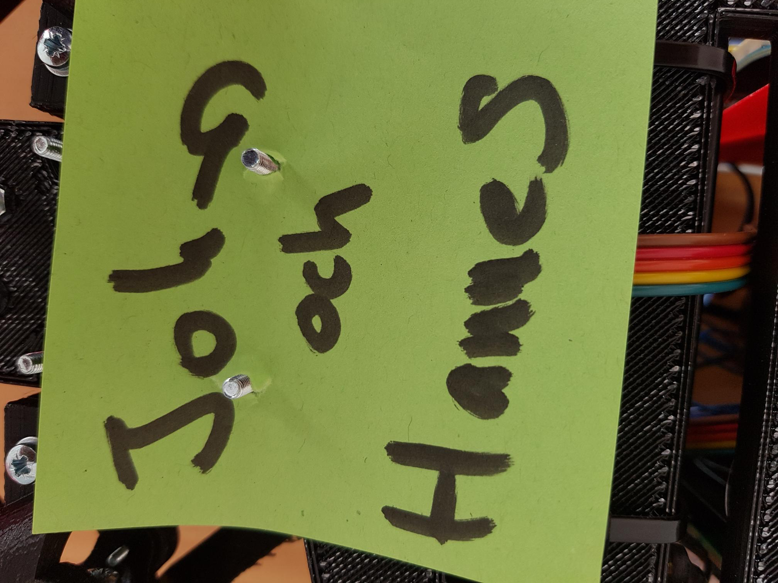
Object detection
WASP SUMMER COURSE 2018
Chose to track an object of known color/shape (post-it note)
Color detection
Shape detection
Contour selection

Slide 5
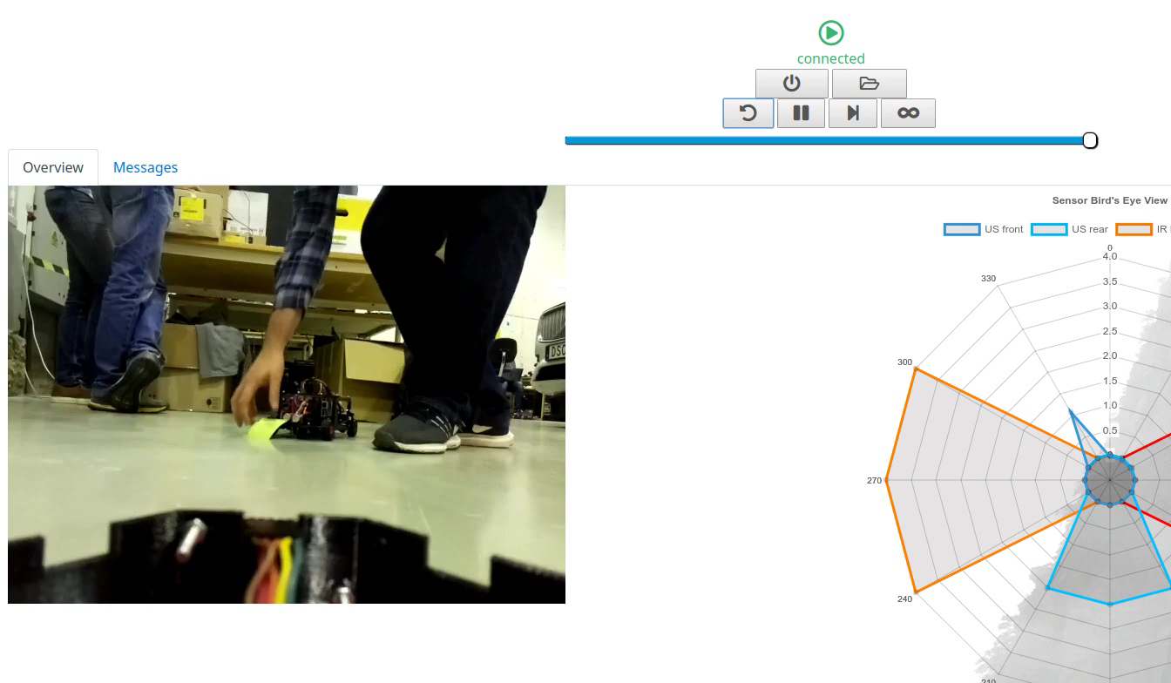
Demo - object detection
WASP SUMMER COURSE 2018

Slide 6
Controlling the kiwi
WASP SUMMER COURSE 2018
Chose a P-Controller on the angle error (relative to center of camera)
Chose a PD-Controller to regulate the distance between approximated distance (from camera) and a setpoint (0.3m)

Slide 7
Collision avoidance
WASP SUMMER COURSE 2018
To ensure no crashes the Kiwi is not permitted to move forwards/backwards/left/right if any object is within a boundary
To do this, we change the permitted maximum steering angle and thrust based on detected objects

Slide 8
demo - kiwi control
WASP SUMMER COURSE 2018

Slide 9
Thanks!
WASP SUMMER COURSE 2018

